Slide 1
Ancient History school resources
Presented by Roth schools outreach program
1 April 2017
Dr Eve Guerry
Roth Fellow for School Outreach
Ancient Israel Program

Slide 2
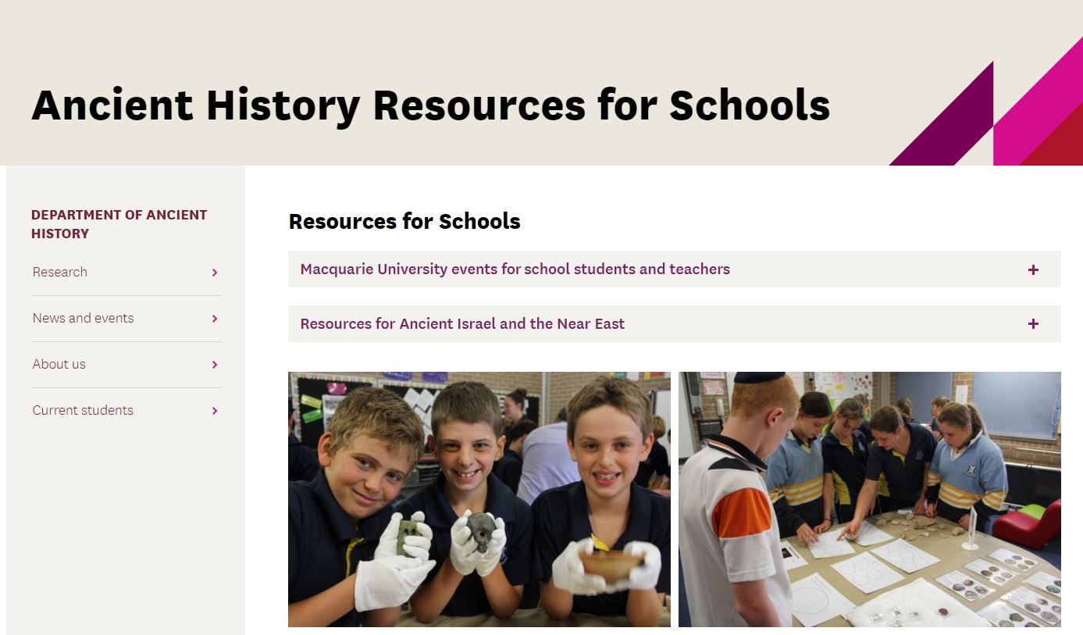
http://mq.edu.au/ancient-history-for-schools

Slide 3
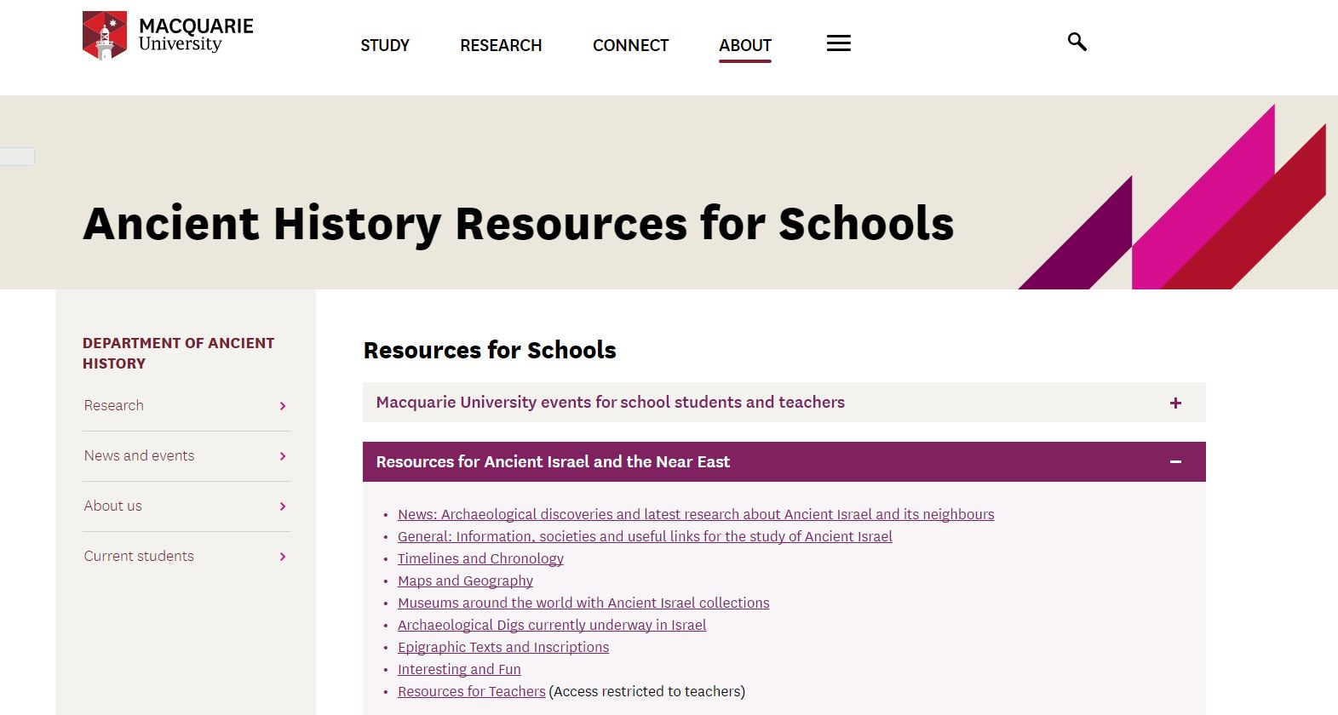
http://mq.edu.au/ancient-history-for-schools

Slide 4
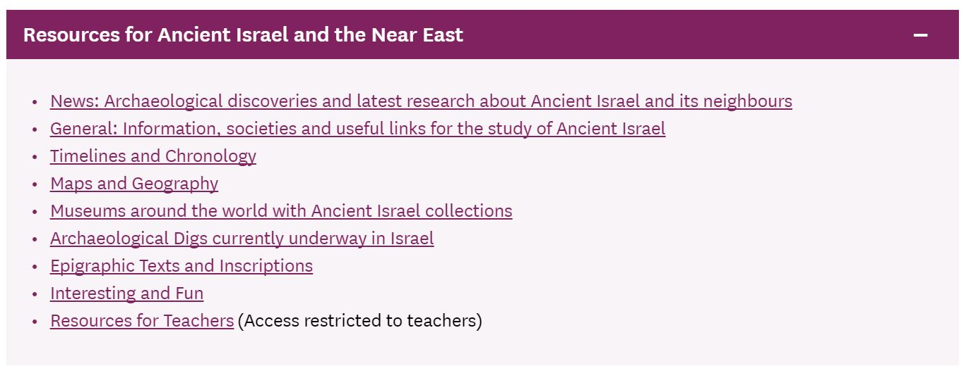
http://mq.edu.au/ancient-history-for-schools

Slide 5
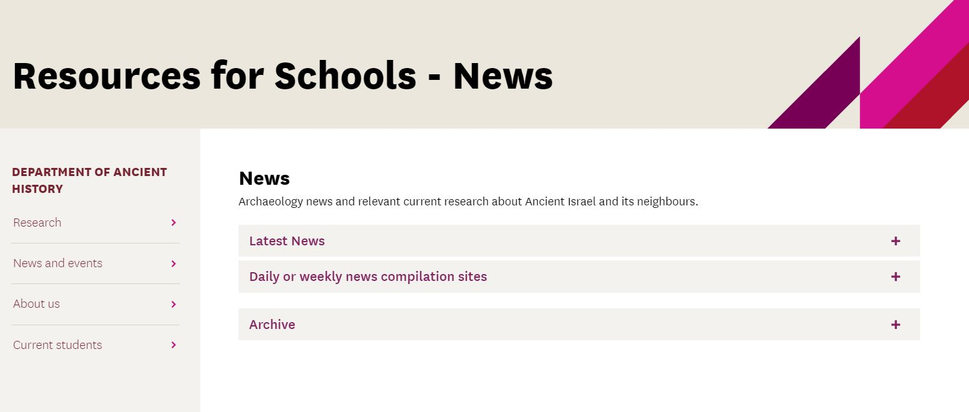
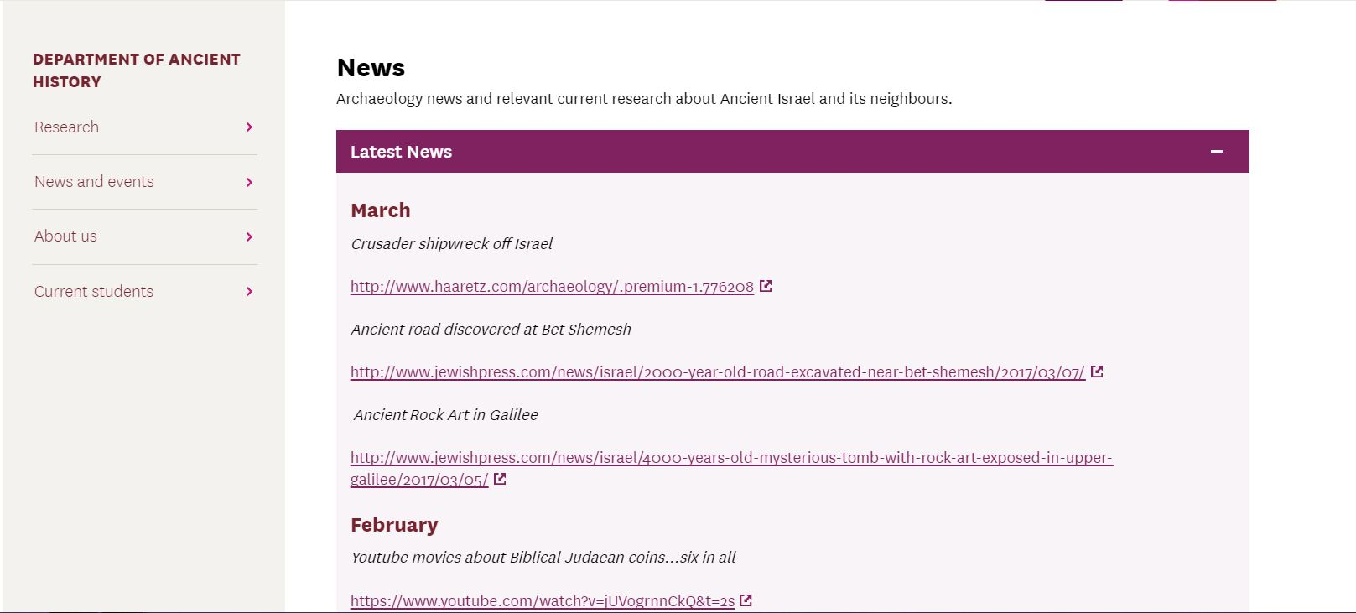
http://mq.edu.au/ancient-history-for-schools

Slide 6
http://mq.edu.au/ancient-history-for-schools

Slide 7
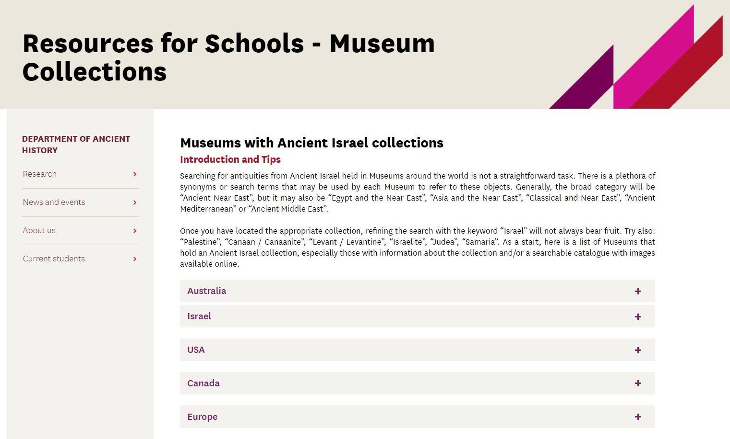
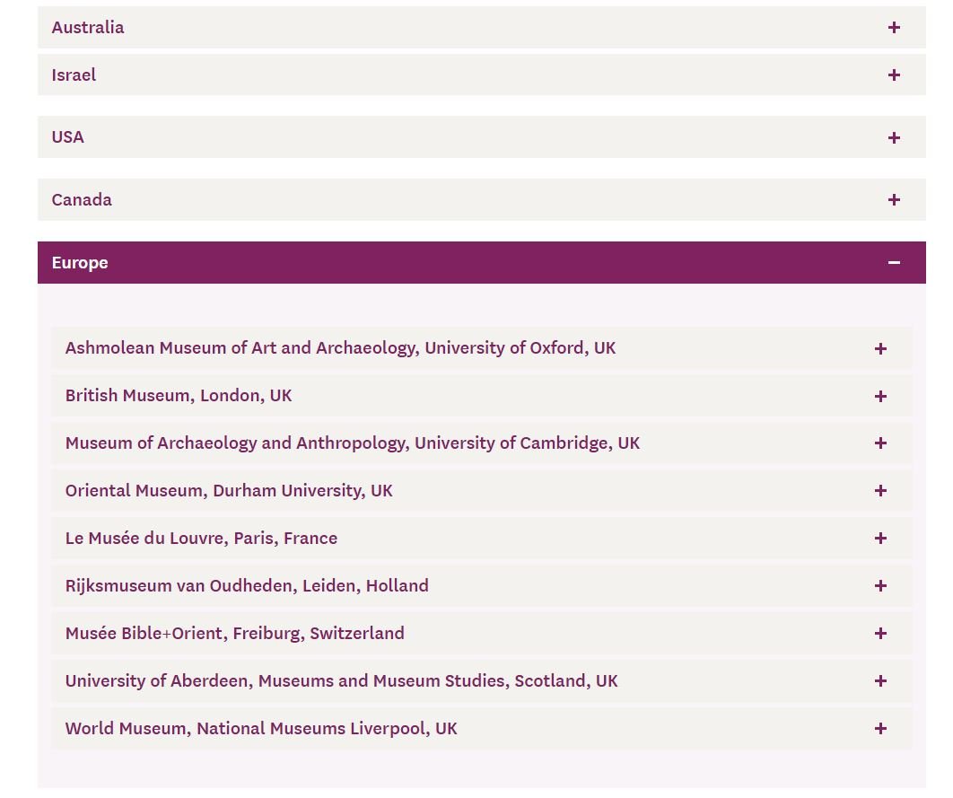
http://mq.edu.au/ancient-history-for-schools

Slide 8
http://mq.edu.au/ancient-history-for-schools

Slide 9
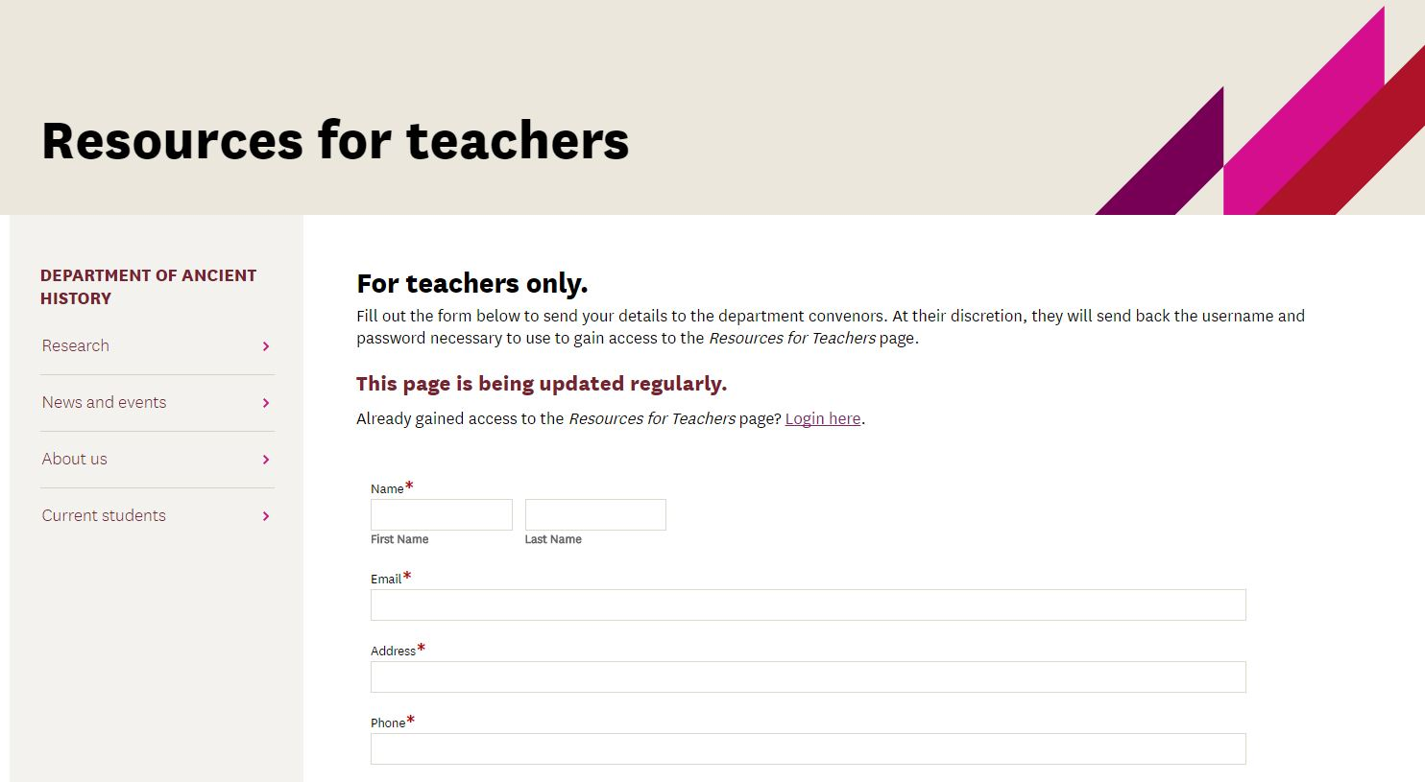
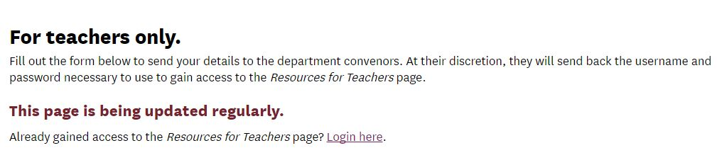
http://mq.edu.au/ancient-history-for-schools

Slide 10
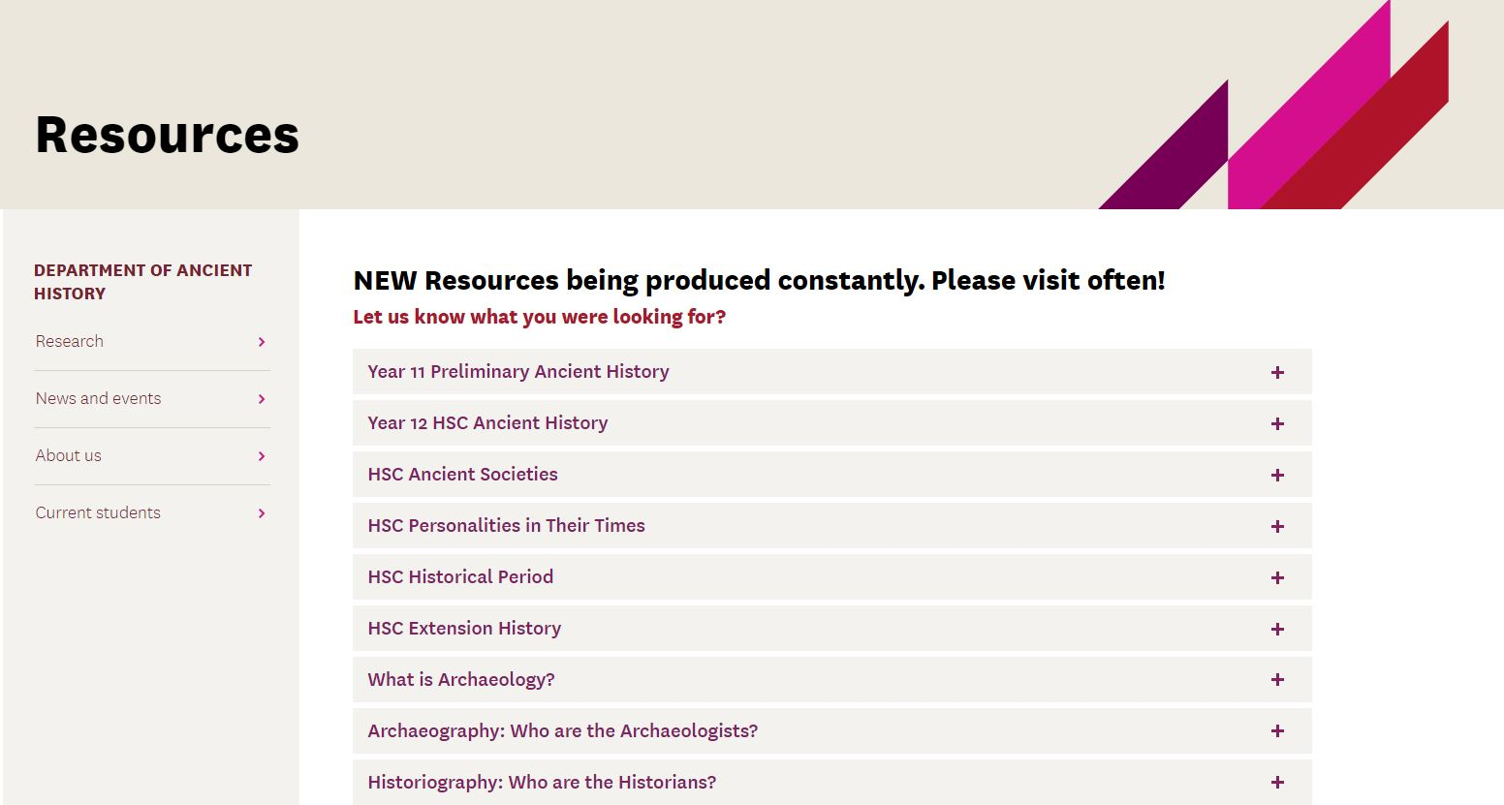
http://mq.edu.au/ancient-history-for-schools

Slide 11
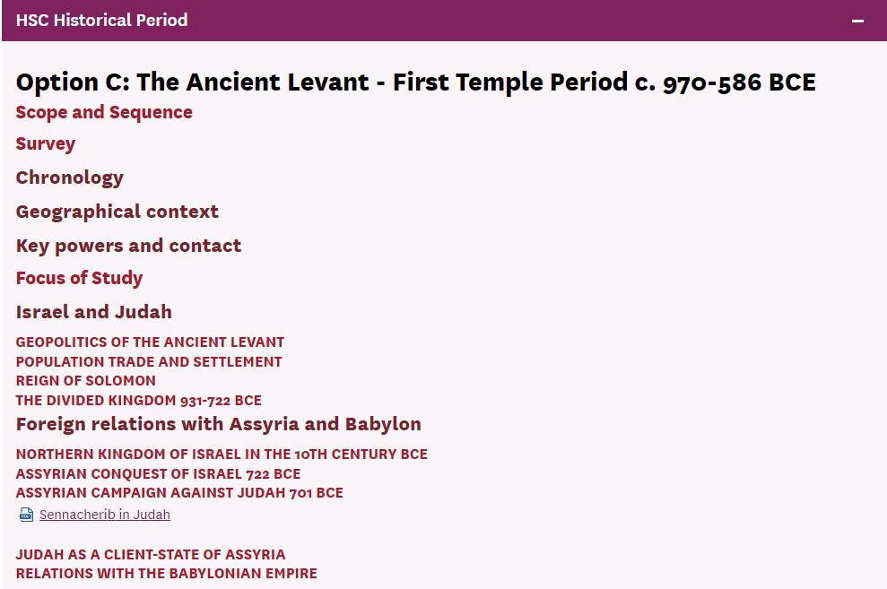
http://mq.edu.au/ancient-history-for-schools

Slide 12
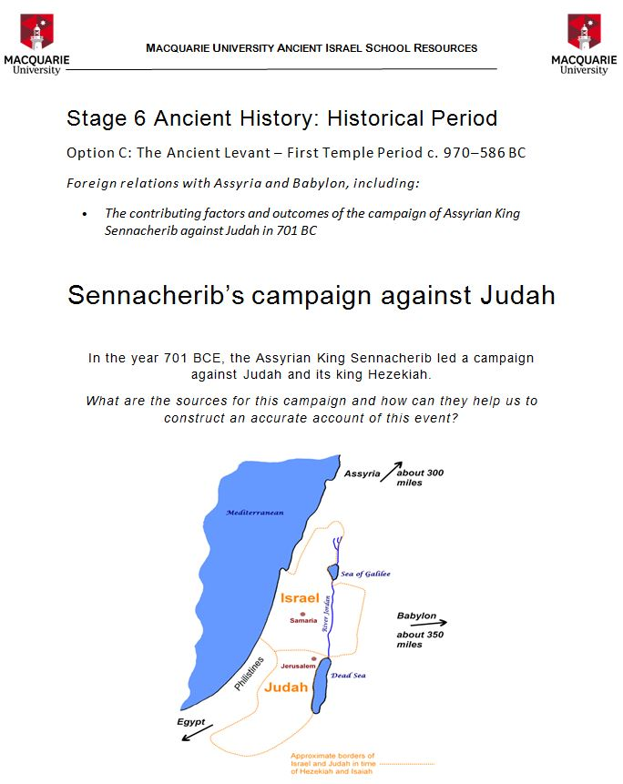
http://mq.edu.au/ancient-history-for-schools

Slide 13
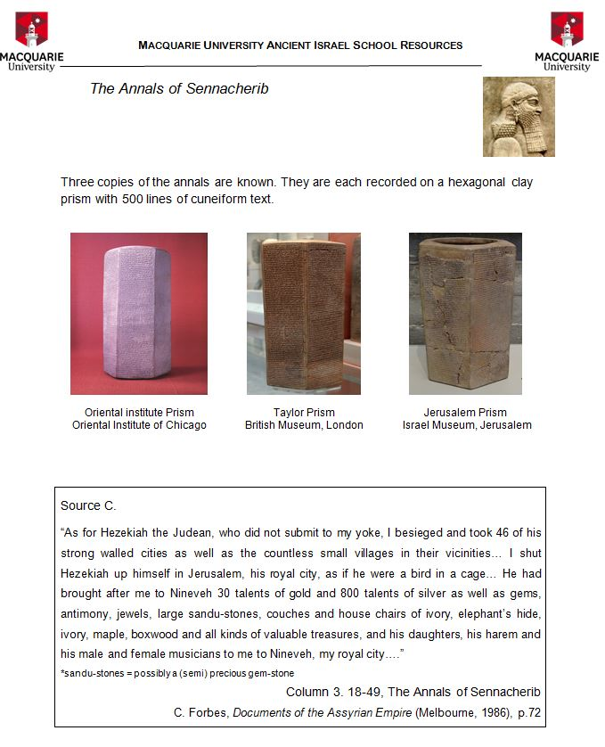
http://mq.edu.au/ancient-history-for-schools

Slide 14
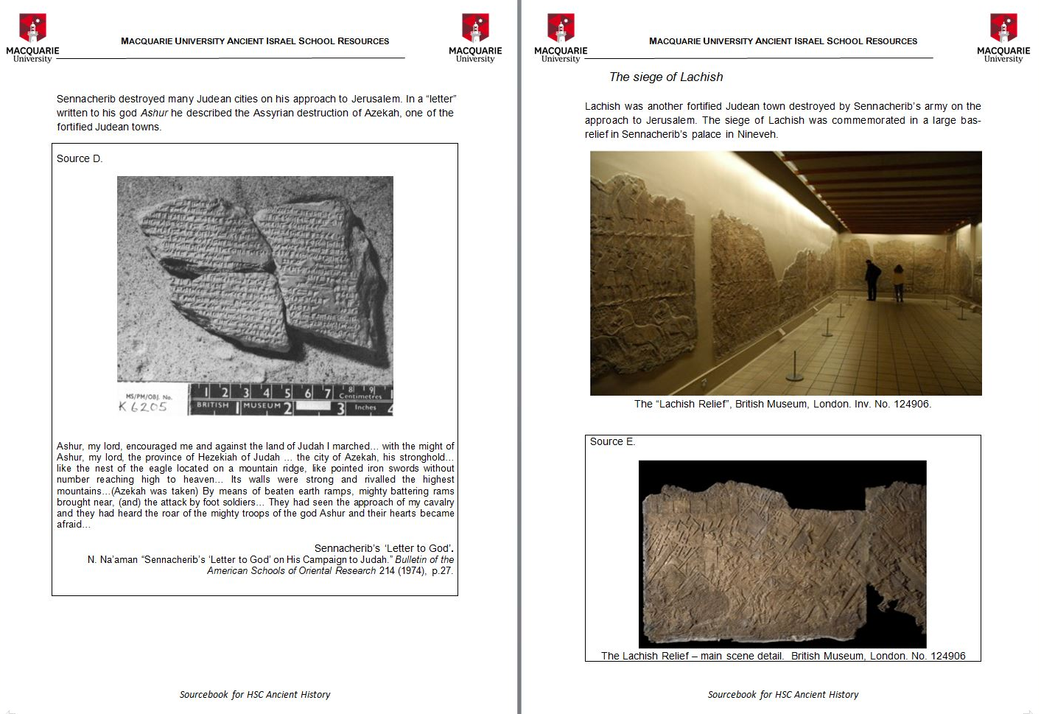
http://mq.edu.au/ancient-history-for-schools

Slide 15
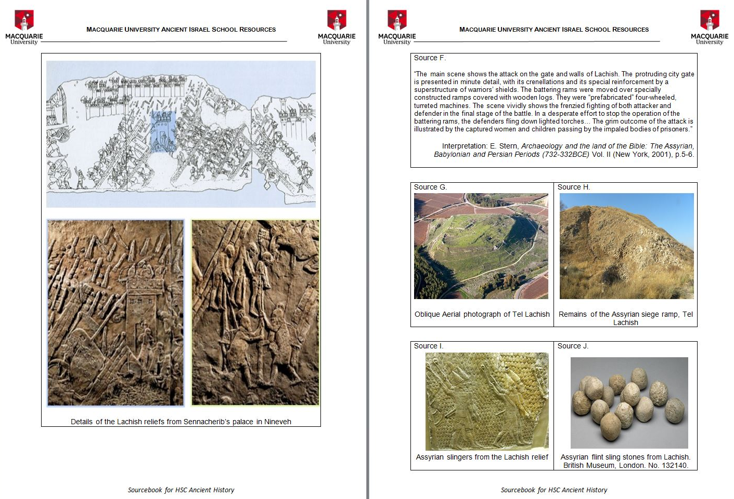
http://mq.edu.au/ancient-history-for-schools

Slide 16
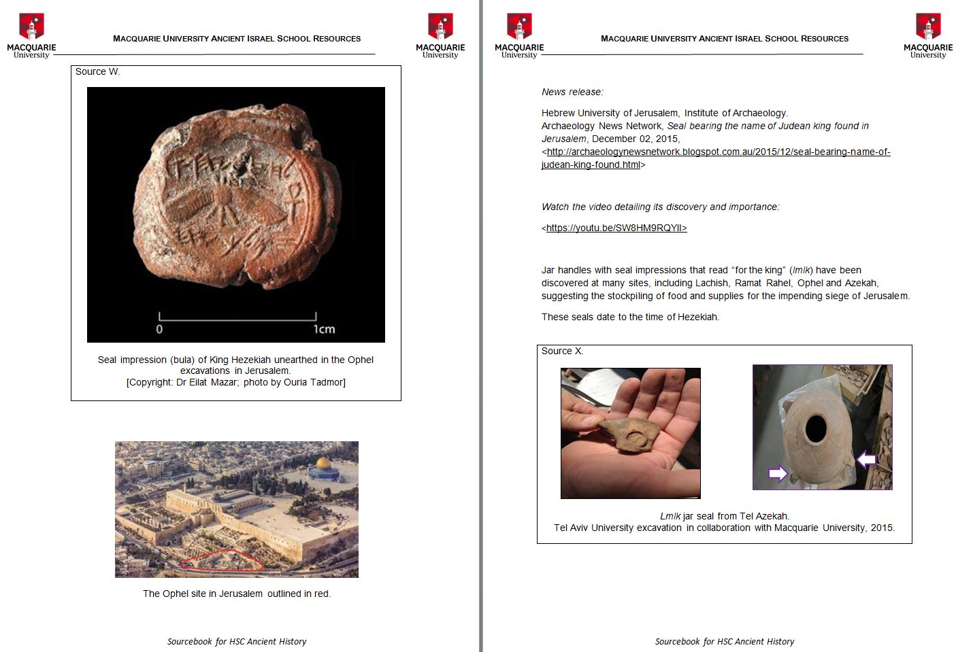
http://mq.edu.au/ancient-history-for-schools

Slide 17
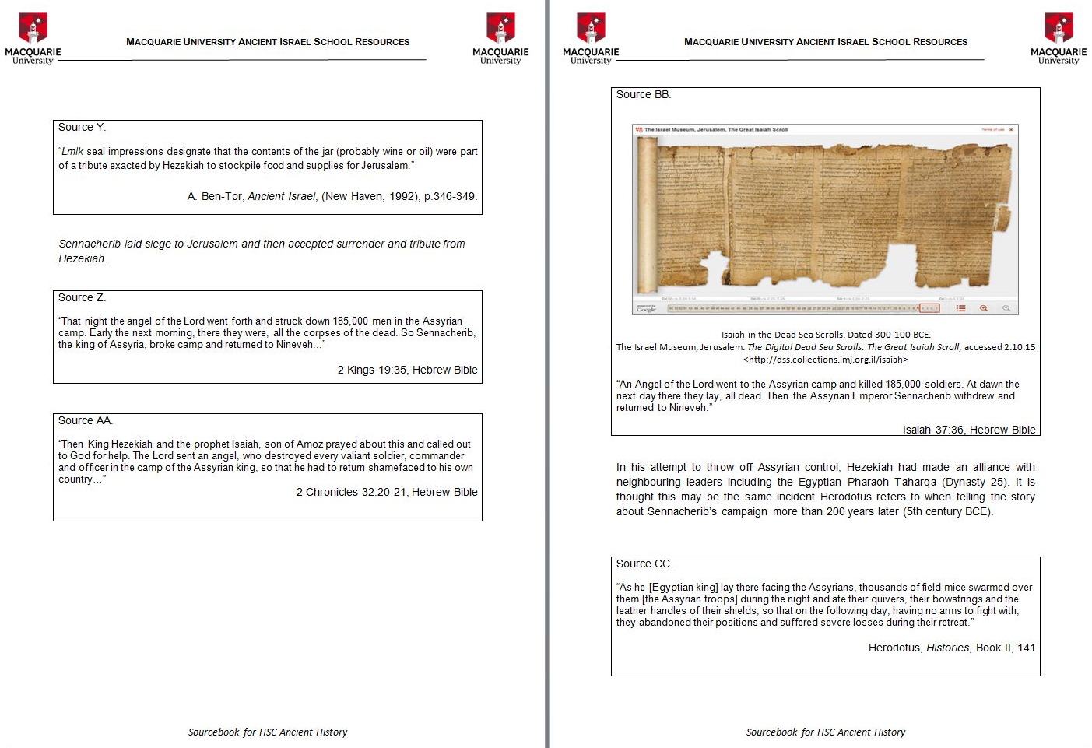
http://mq.edu.au/ancient-history-for-schools

